Slide 1
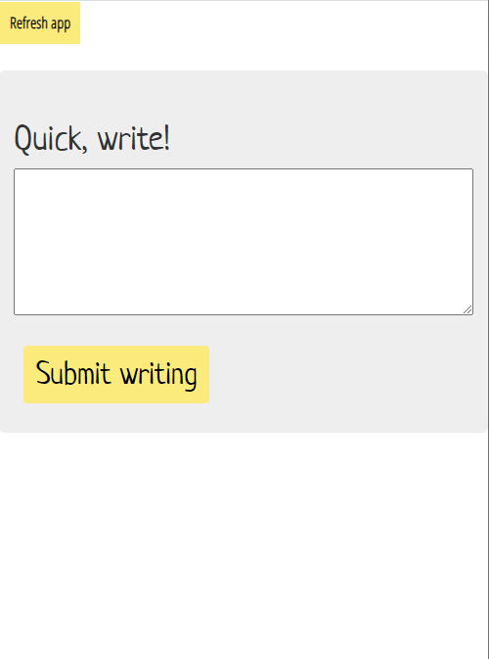
Send me a music rec! Or ask a question about the course
Go to
link.lizabolton.com/slinky

Slide 2


Slide 3
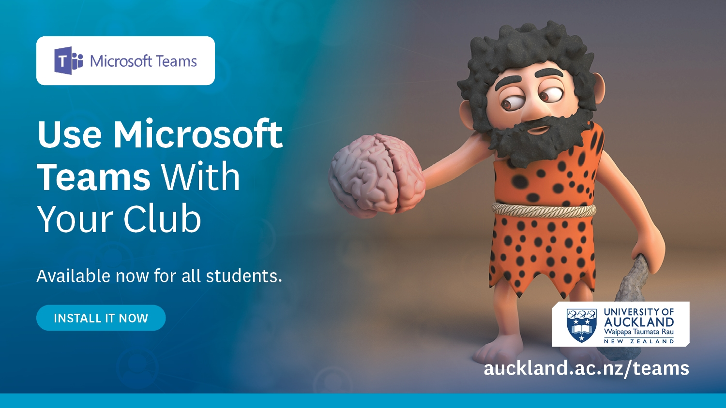

Slide 4


Slide 5


Slide 6


Slide 7


Slide 8


Slide 9


Slide 10


Slide 11


Slide 12


Slide 13
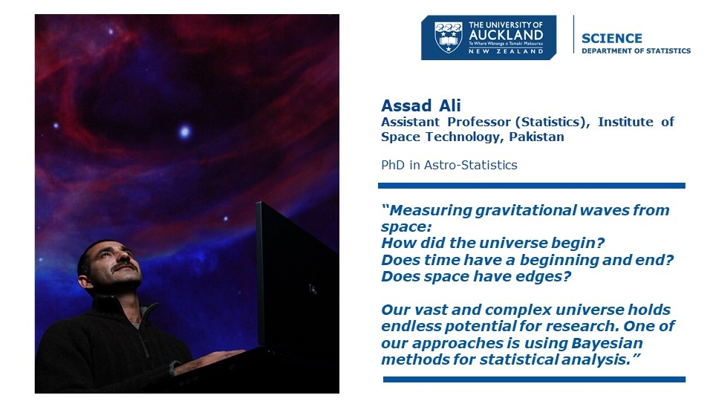

Slide 14
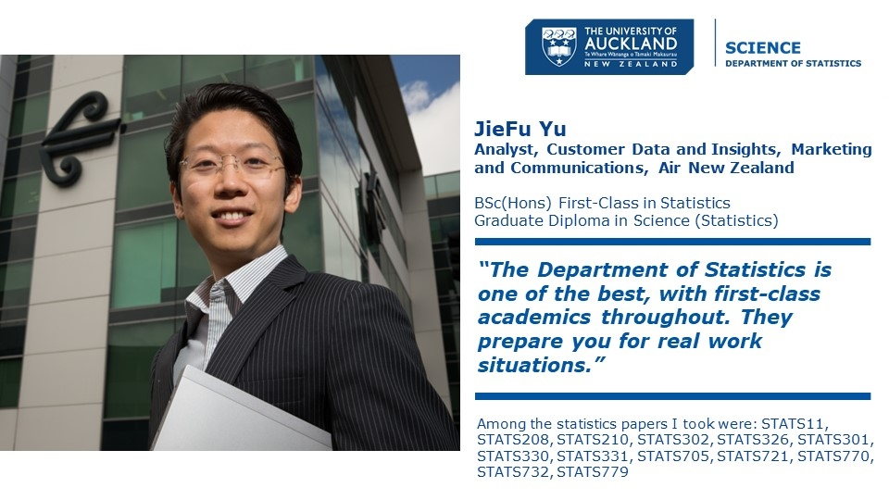

Slide 15
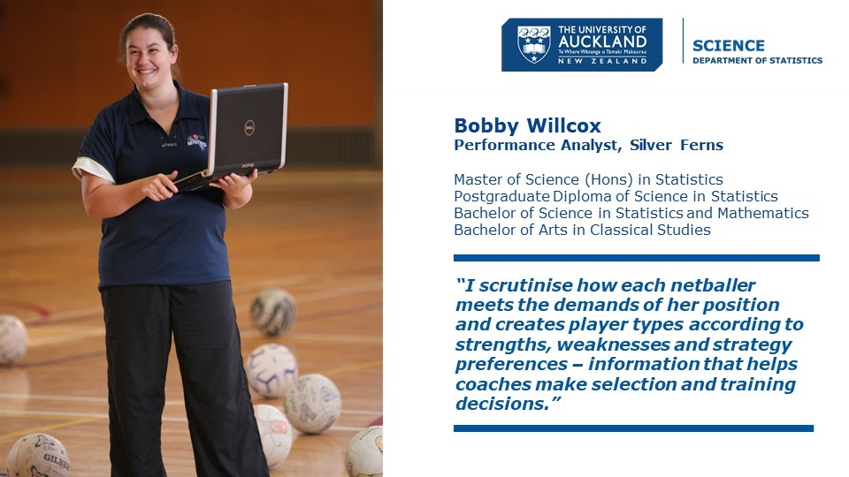

Slide 16
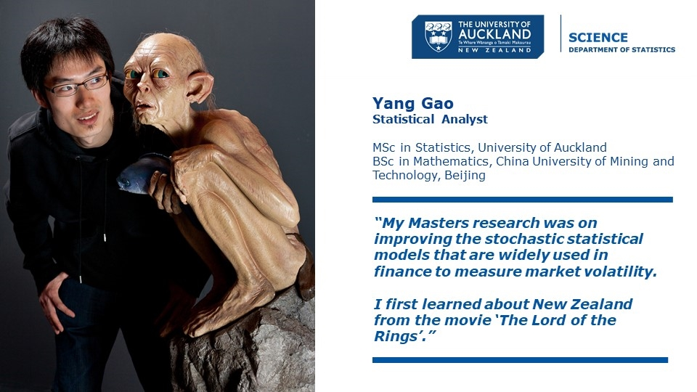

Slide 17


Slide 18
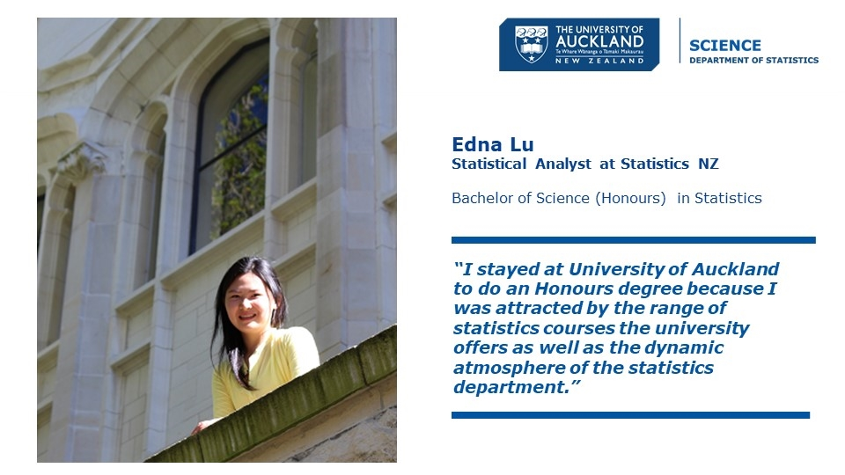

Slide 19
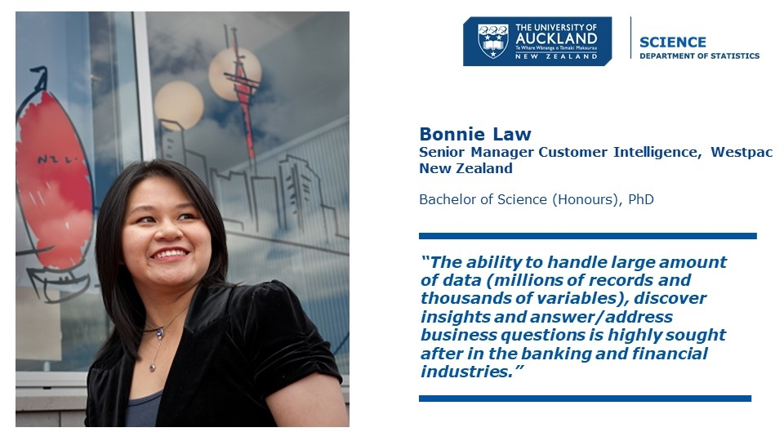

Slide 20


Slide 21


Slide 22


Slide 23


Slide 24


Slide 25


Slide 26
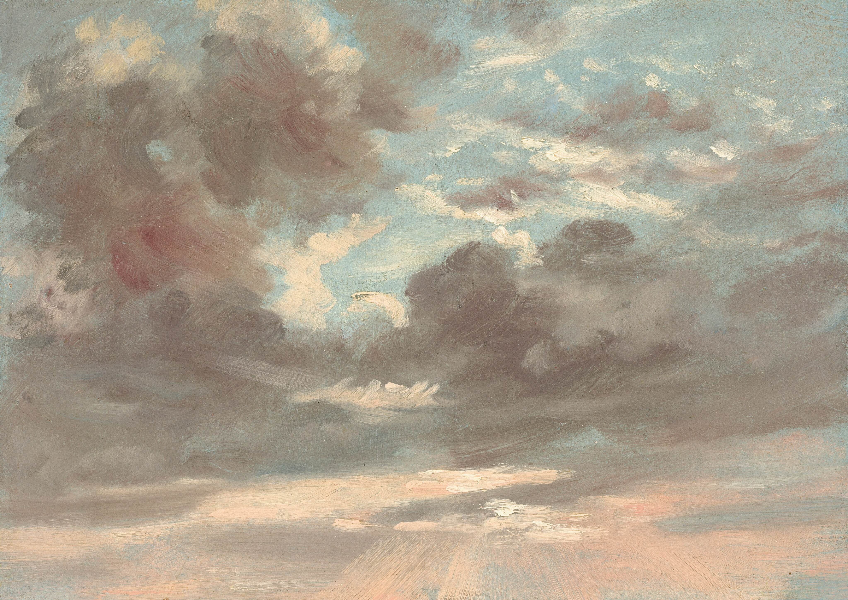
"Numerical quantities focus on expected values, graphical summaries on unexpected values."
- John Tukey
Art by John Constable

Slide 27
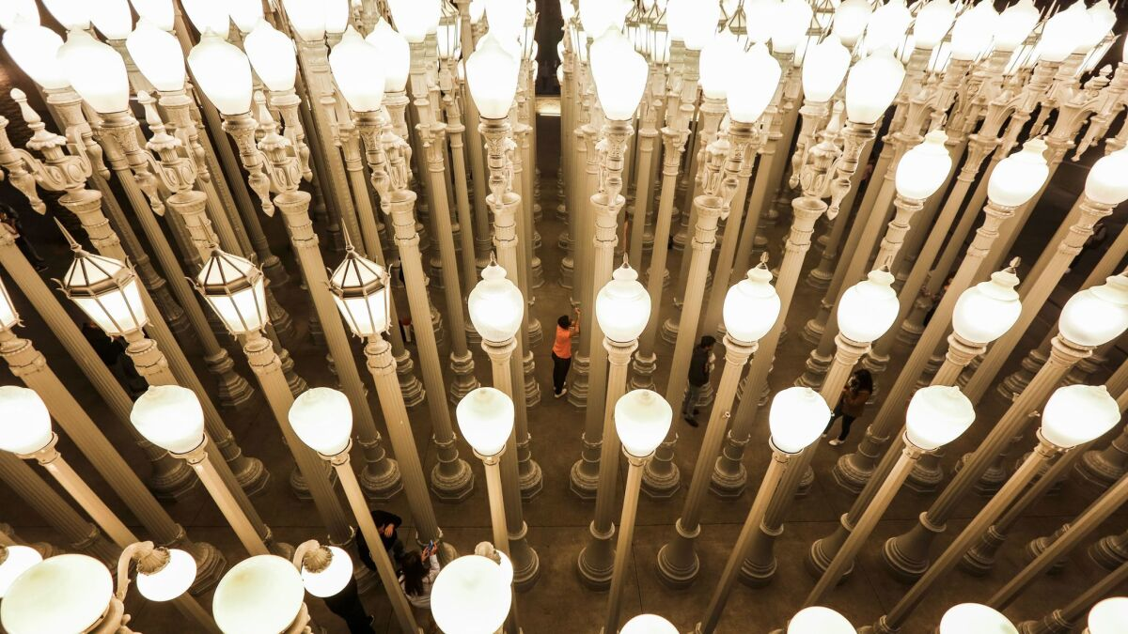
"He uses statistics as a drunken man uses lamp-posts—for support rather than illumination."
- Andrew Lang
Chris Burden’s “Urban Light” installation at LACMA . Photo by Maria Alejandra Cardona / Los Angeles Times

Slide 28
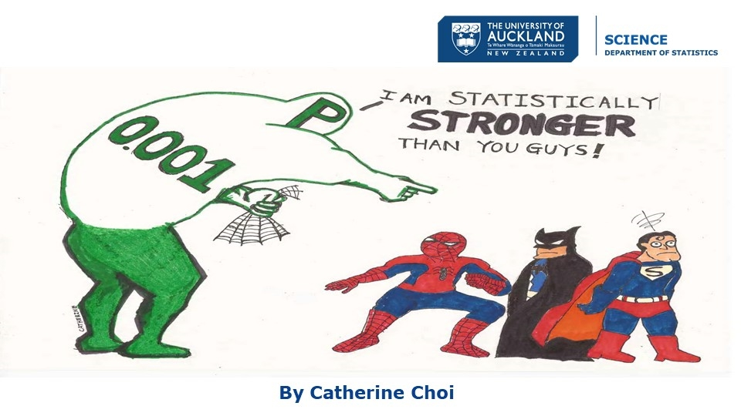

Slide 29
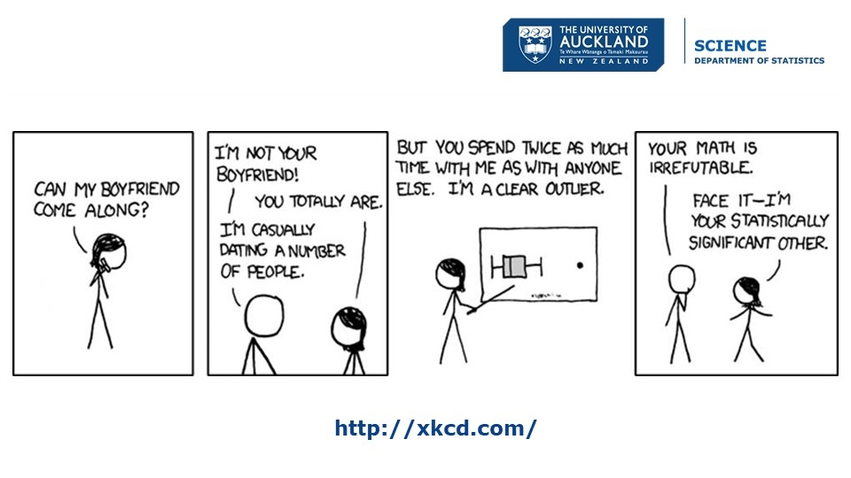

Slide 30
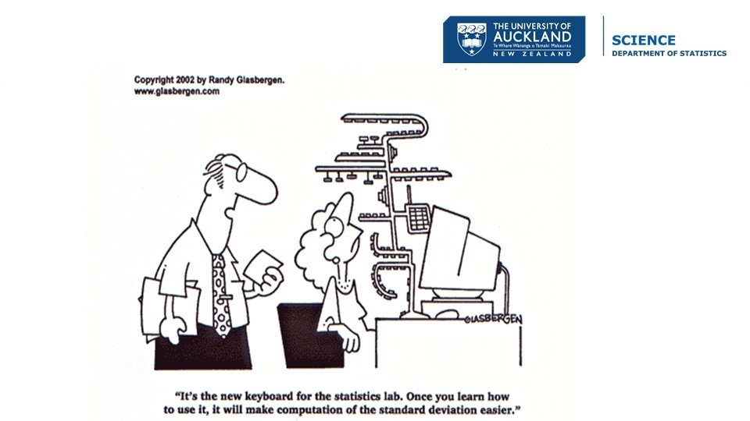

Slide 31
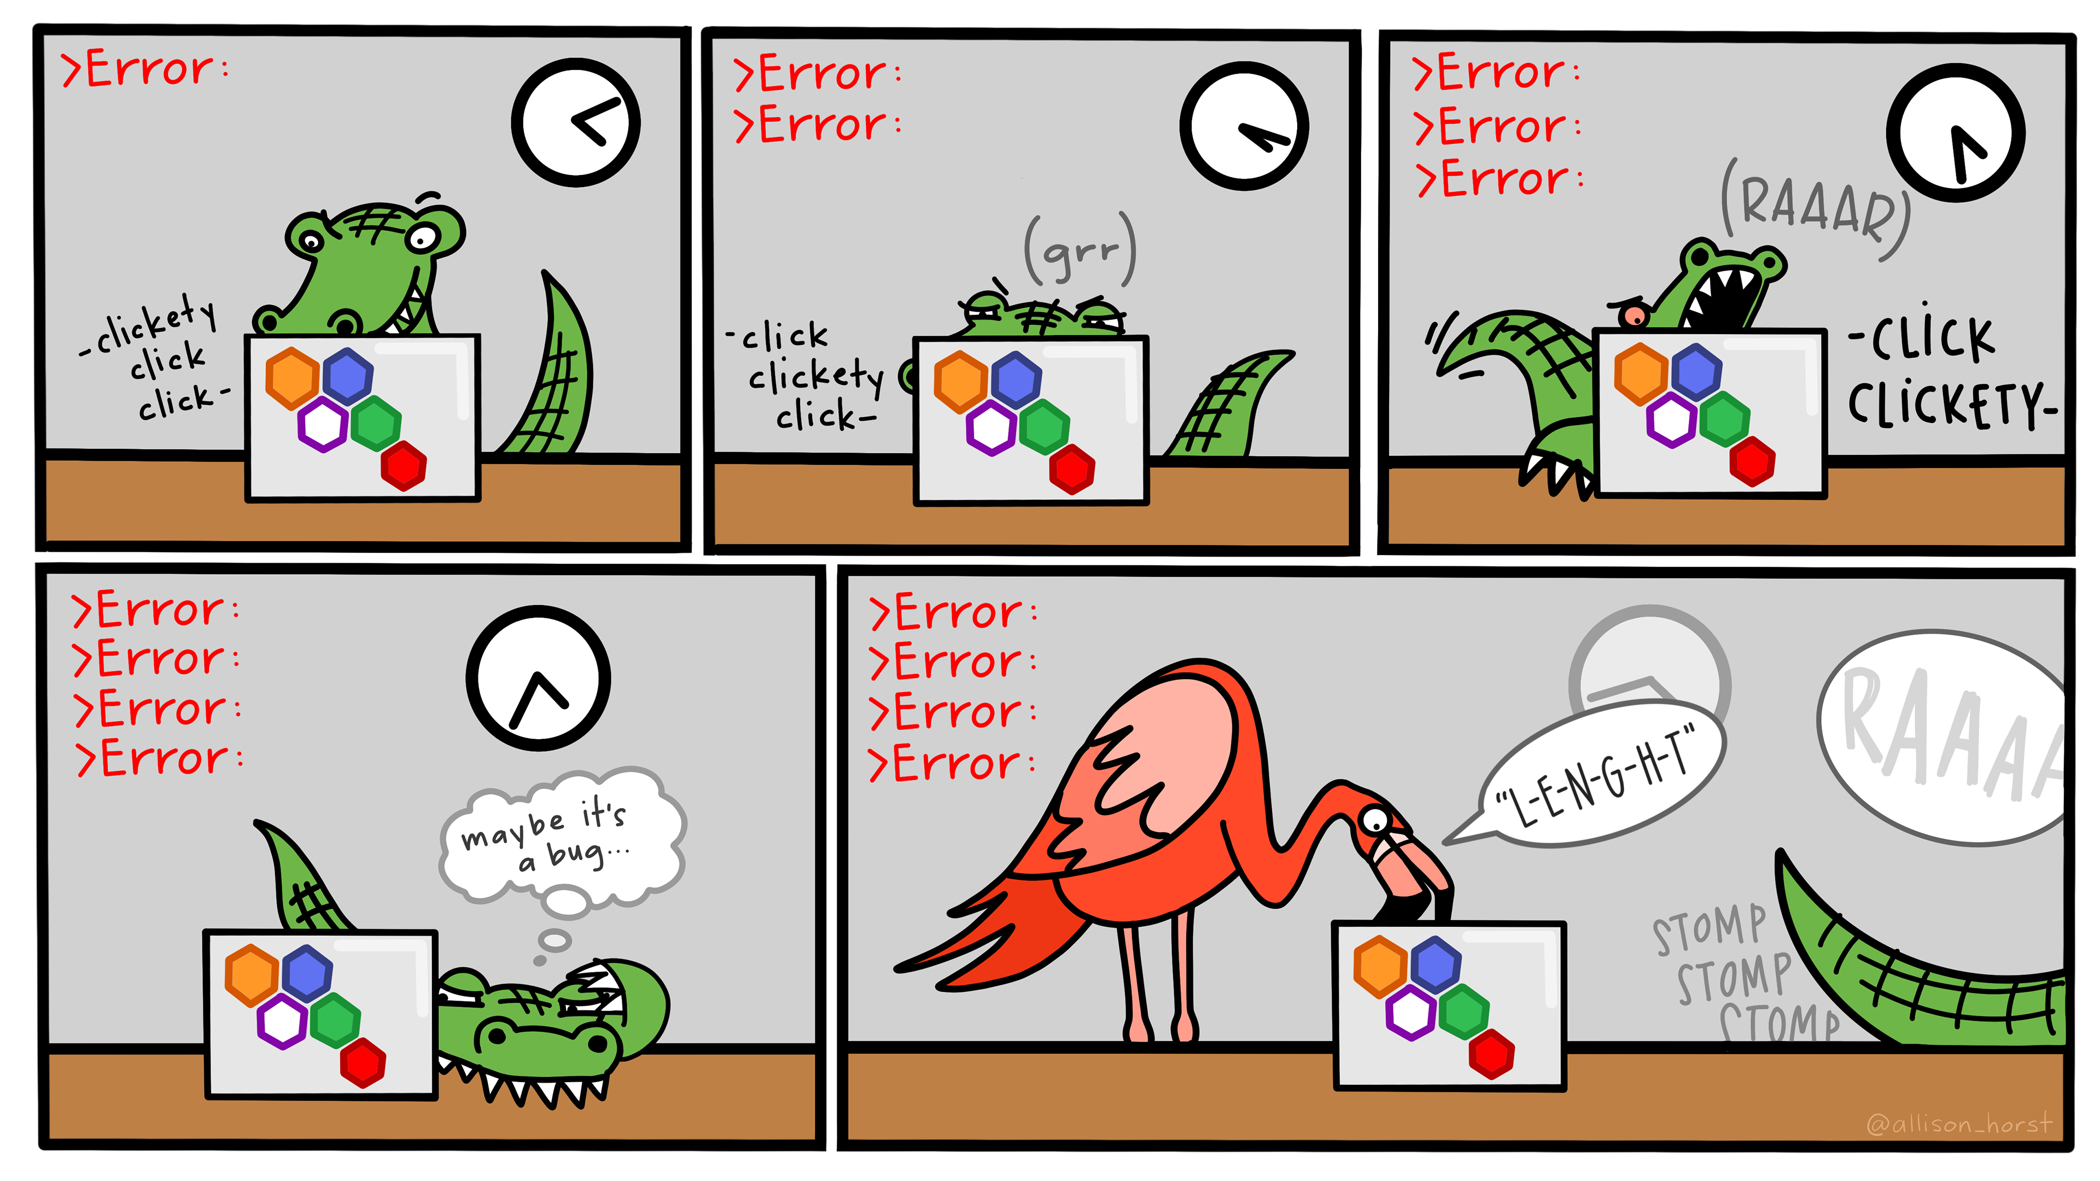
Notes:
Comic panels of an alligator trying to debug some code. First panel: A confident looking alligator gets an error message. Second panel: a few minutes later, the error remains and the alligator is looking carefully at their code. Third panel: 10 minutes after that, the error remains and the alligator is giving a frustrated "RAAAR" while desperately typing. Fourth panel: The error remains, and the alligator looks exhausted and exasperated, and a thought bubble reads "maybe it's a bug." Fifth panel: A friendly flamingo comes over to take a look, and reads aloud from the problematic code a spelling error: "L-E-N-G-H-T." Only the tail of the alligator is visible as it stomp stomp stomps out of the panel roaring. https://allisonhorst.com/everything-else

Slide 32
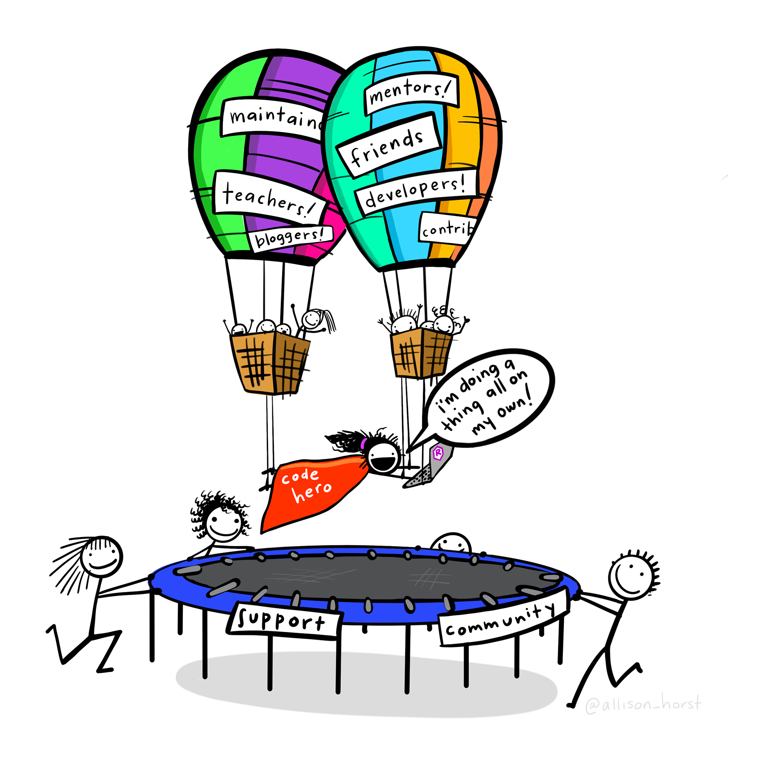
Notes:
A person in a cape that reads “code hero” who looks like they are flying through the air while typing on a computer while saying “I’m doing a think all on my own!” The coder’s arms and legs have ropes attached to two hot air balloons lifting them up, with labels on the balloons including “teachers”, “bloggers”, “friends”, “developers”. Below the code hero, several people carry a trampoline with labels “support” and “community” that will catch them if they fall

Slide 33
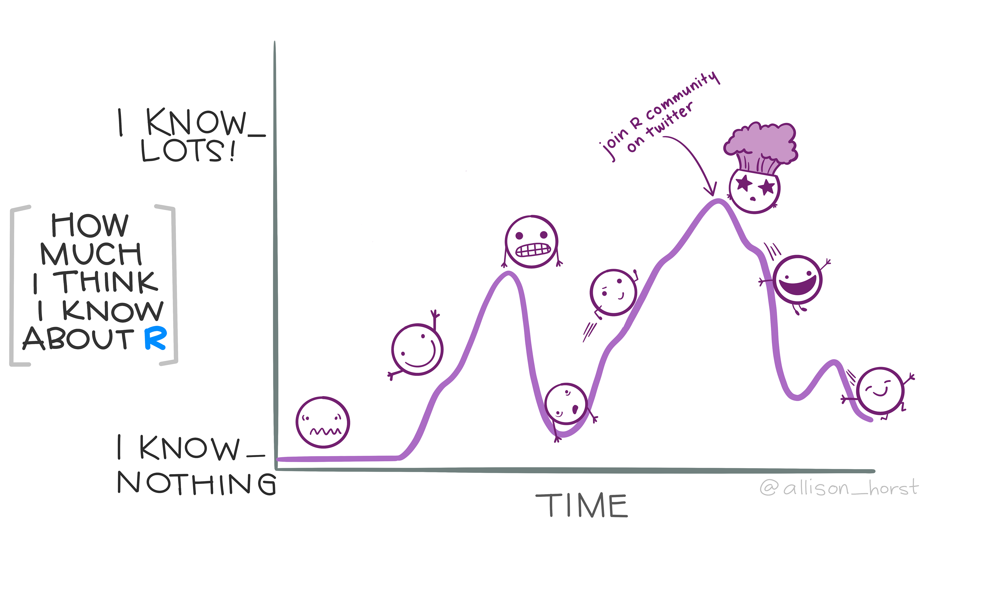
Notes:
Illustrated line plot of "How much I think I know about R" on the y-axis, and "Time" on the x-axis. Along the line are emoji-style faces, showing the non-linear progression of R knowledge over time. At first, a nervous face becomes a happy face early on in learning, then a "grimace" face at an intermediate peak before a steep decline (with an exhausted face at the local minimum). Then, a determined face charges back up a hill, reaching another peak with a "mind blown" face and text annotation "join R community on twitter" followed by another decline, but this time the faces look happy even though their "How much I think I know about R" value is declining.

Slide 34
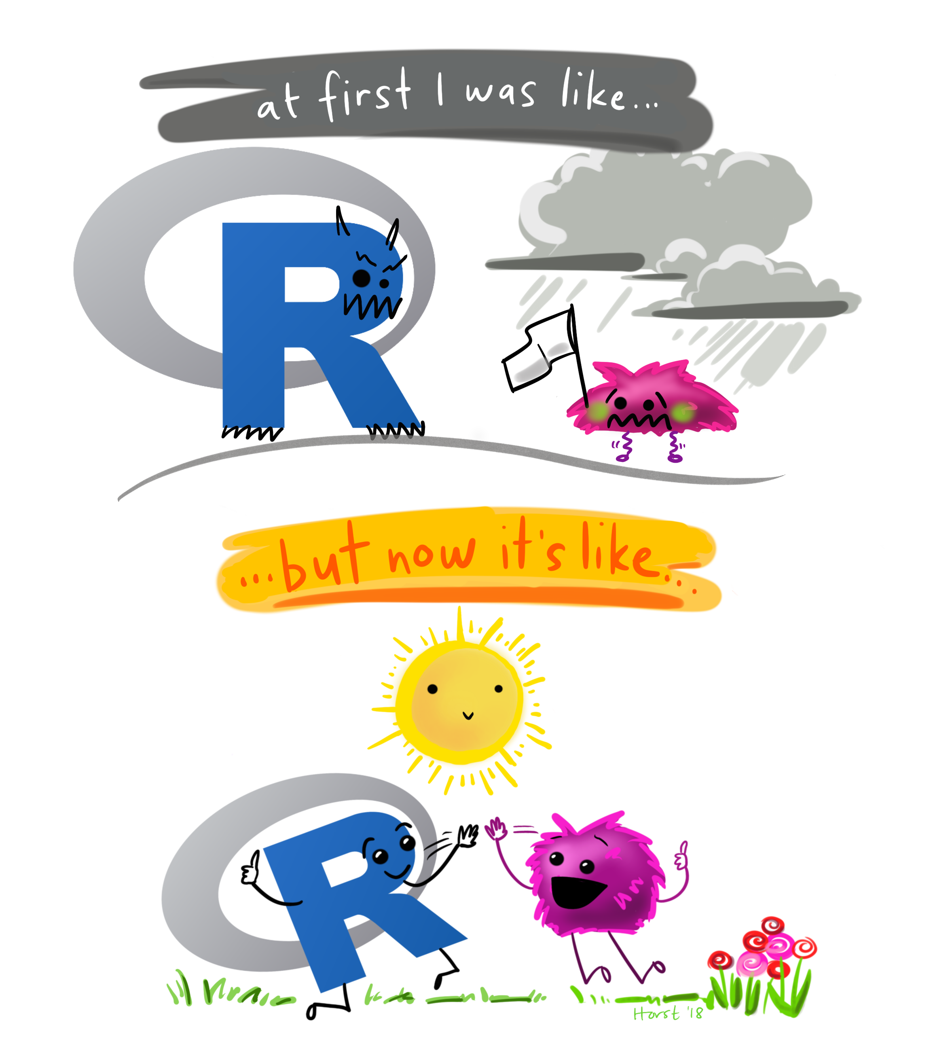
Notes:
A digital cartoon with two illustrations: the top shows the R-logo with a scary face, and a small scared little fuzzy monster holding up a white flag in surrender while under a dark storm cloud. The text above says “at first I was like…” The lower cartoon is a friendly, smiling R-logo jumping up to give a happy fuzzy monster a high-five under a smiling sun and next to colorful flowers. The text above the bottom illustration reads “but now it’s like…”

Slide 35
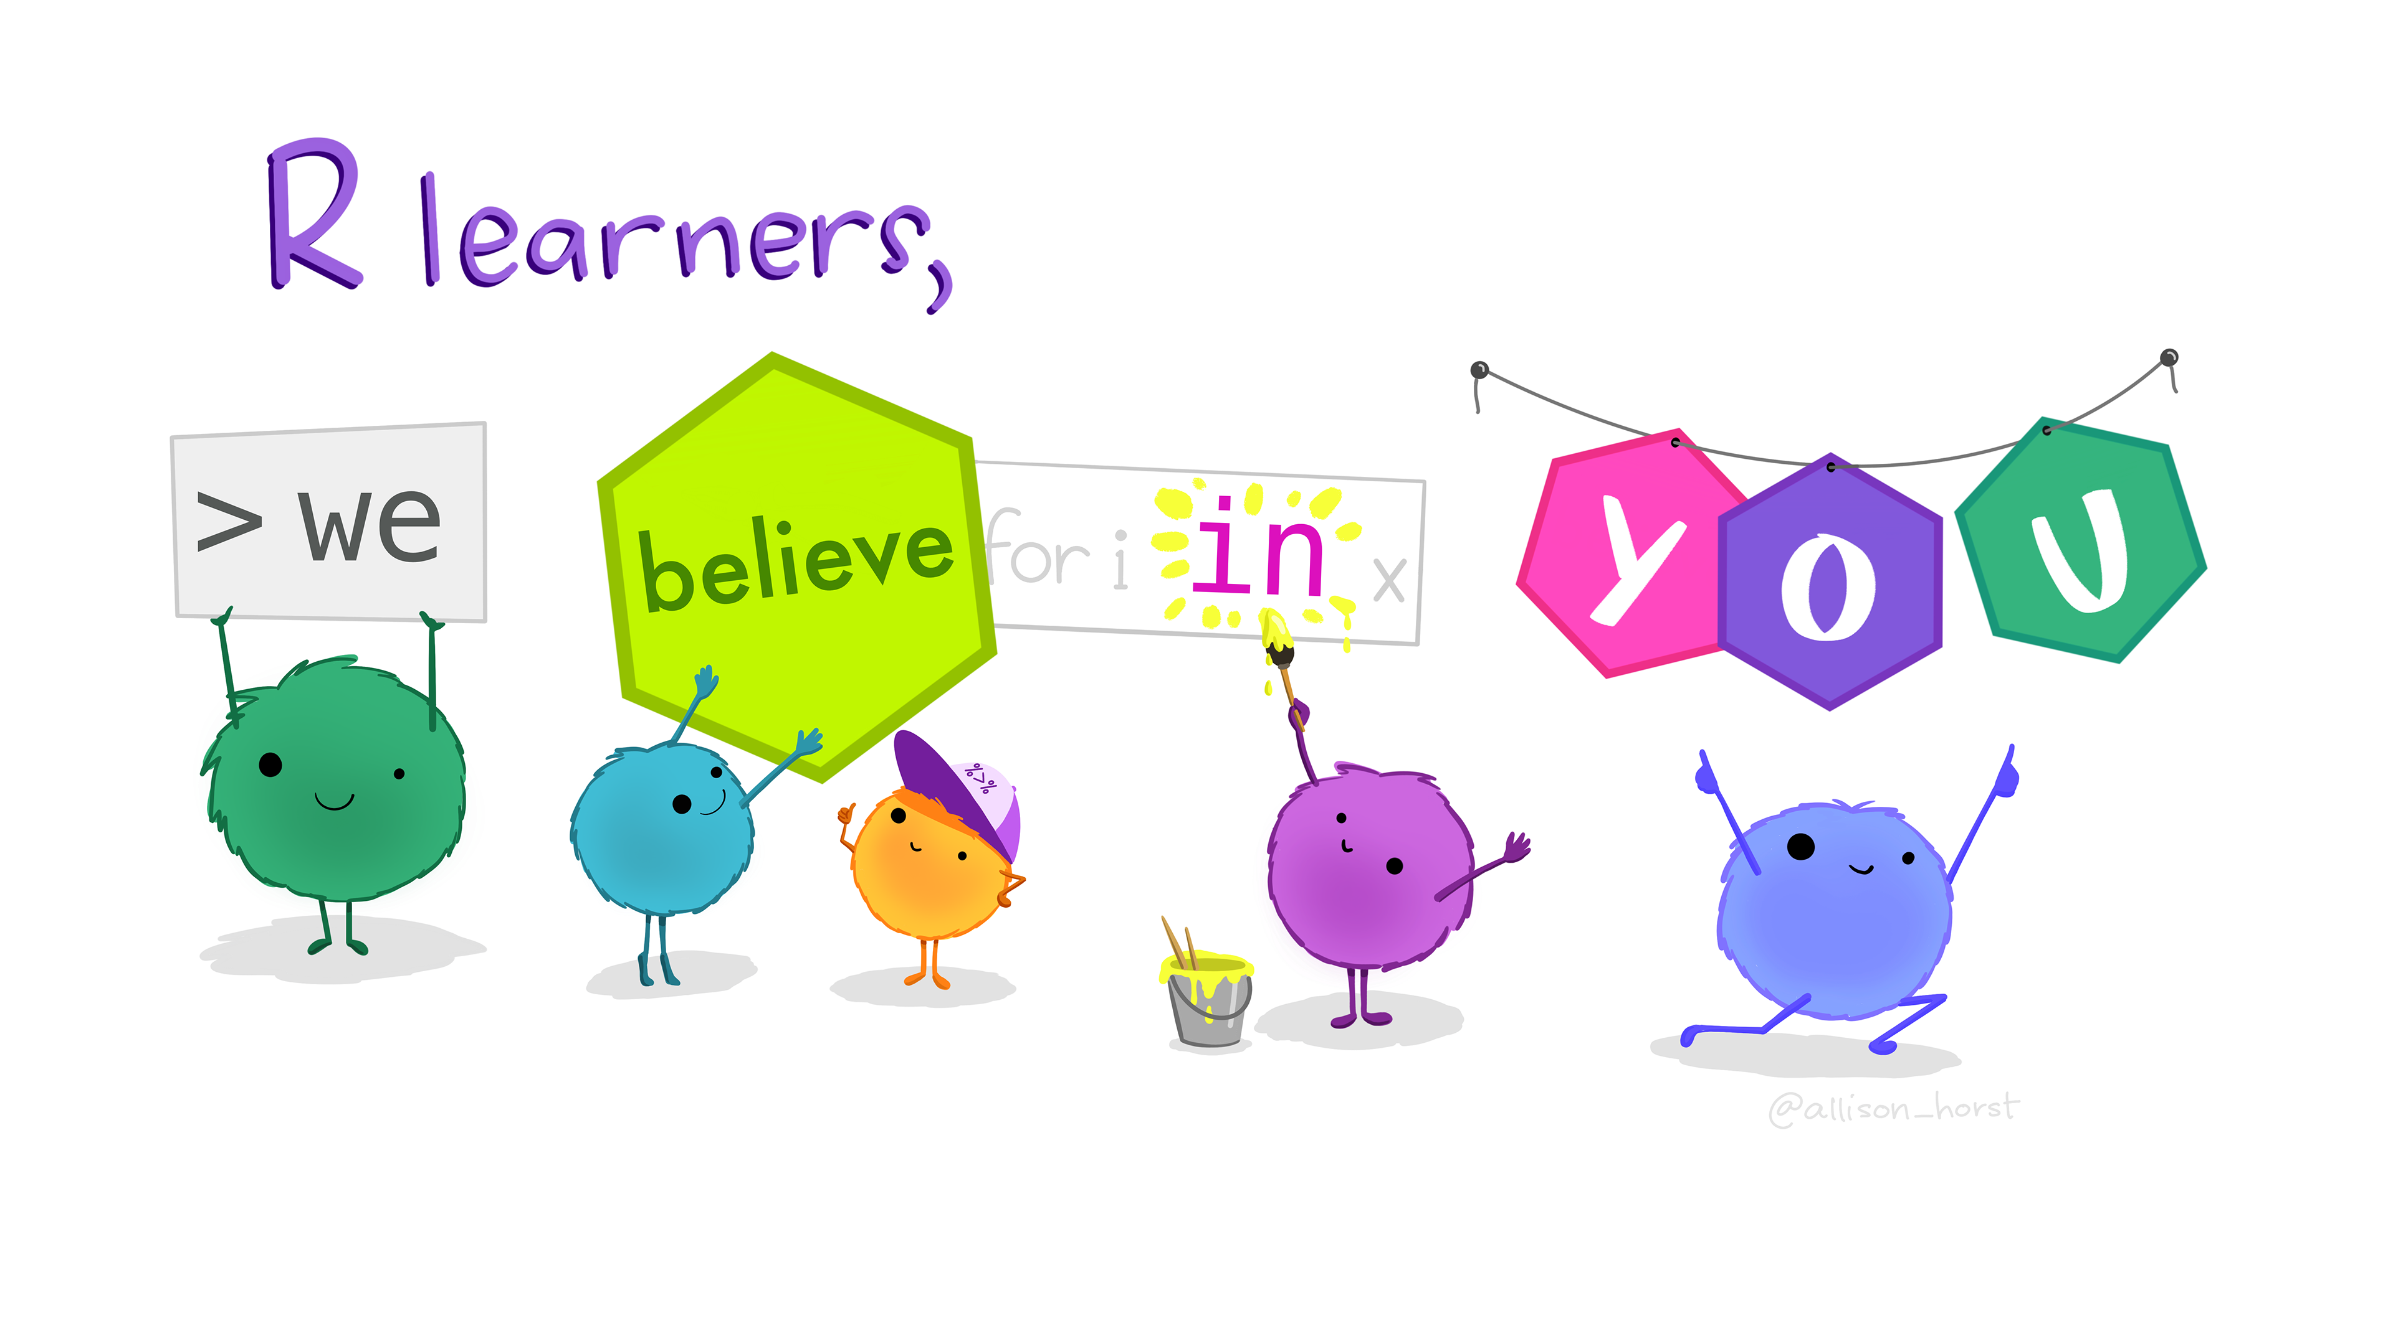
Notes:
Header text "R learners" above five friendly monsters holding up signs that together read “we believe in you.”

Slide 36
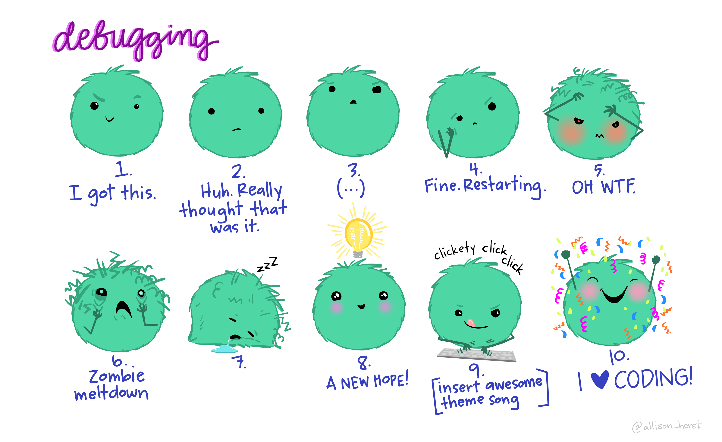
Notes:
A cartoon of a fuzzy round monster face showing 10 different emotions experienced during the process of debugging code. The progression goes from (1) “I got this” - looking determined and optimistic; (2) “Huh. Really thought that was it.” - looking a bit baffled; (3) “...” - looking up at the ceiling in thought; (4) “Fine. Restarting.” - looking a bit annoyed; (5) “OH WTF.” Looking very frazzled and frustrated; (6) “Zombie meltdown.” - looking like a full meltdown; (7) (blank) - sleeping; (8) “A NEW HOPE!” - a happy looking monster with a lightbulb above; (9) “insert awesome theme song” - looking determined and typing away; (10) “I love coding” - arms raised in victory with a big smile, with confetti falling.

Slide 37
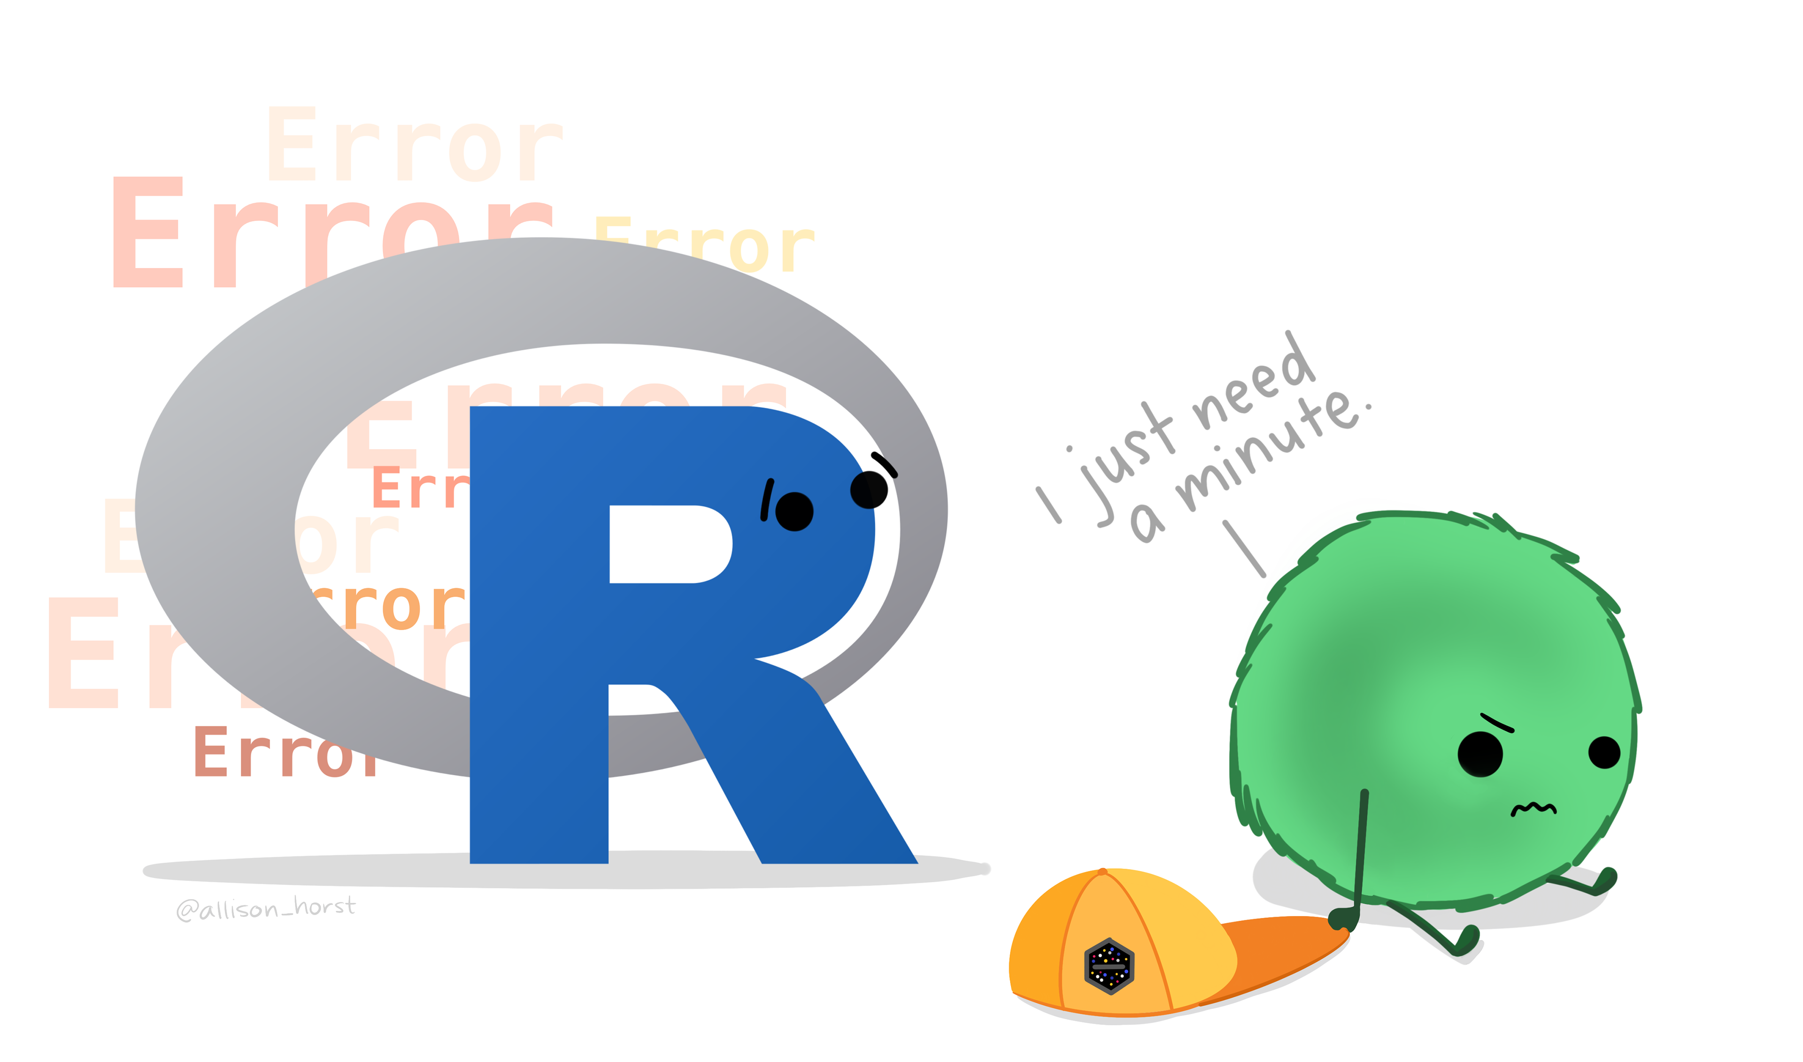
Notes:
A frustrated little monster sits on the ground with his hat next to him, saying "I just need a minute." Looking on empathetically is the R logo, with the word "Error" in many different styles behind it.

Slide 38
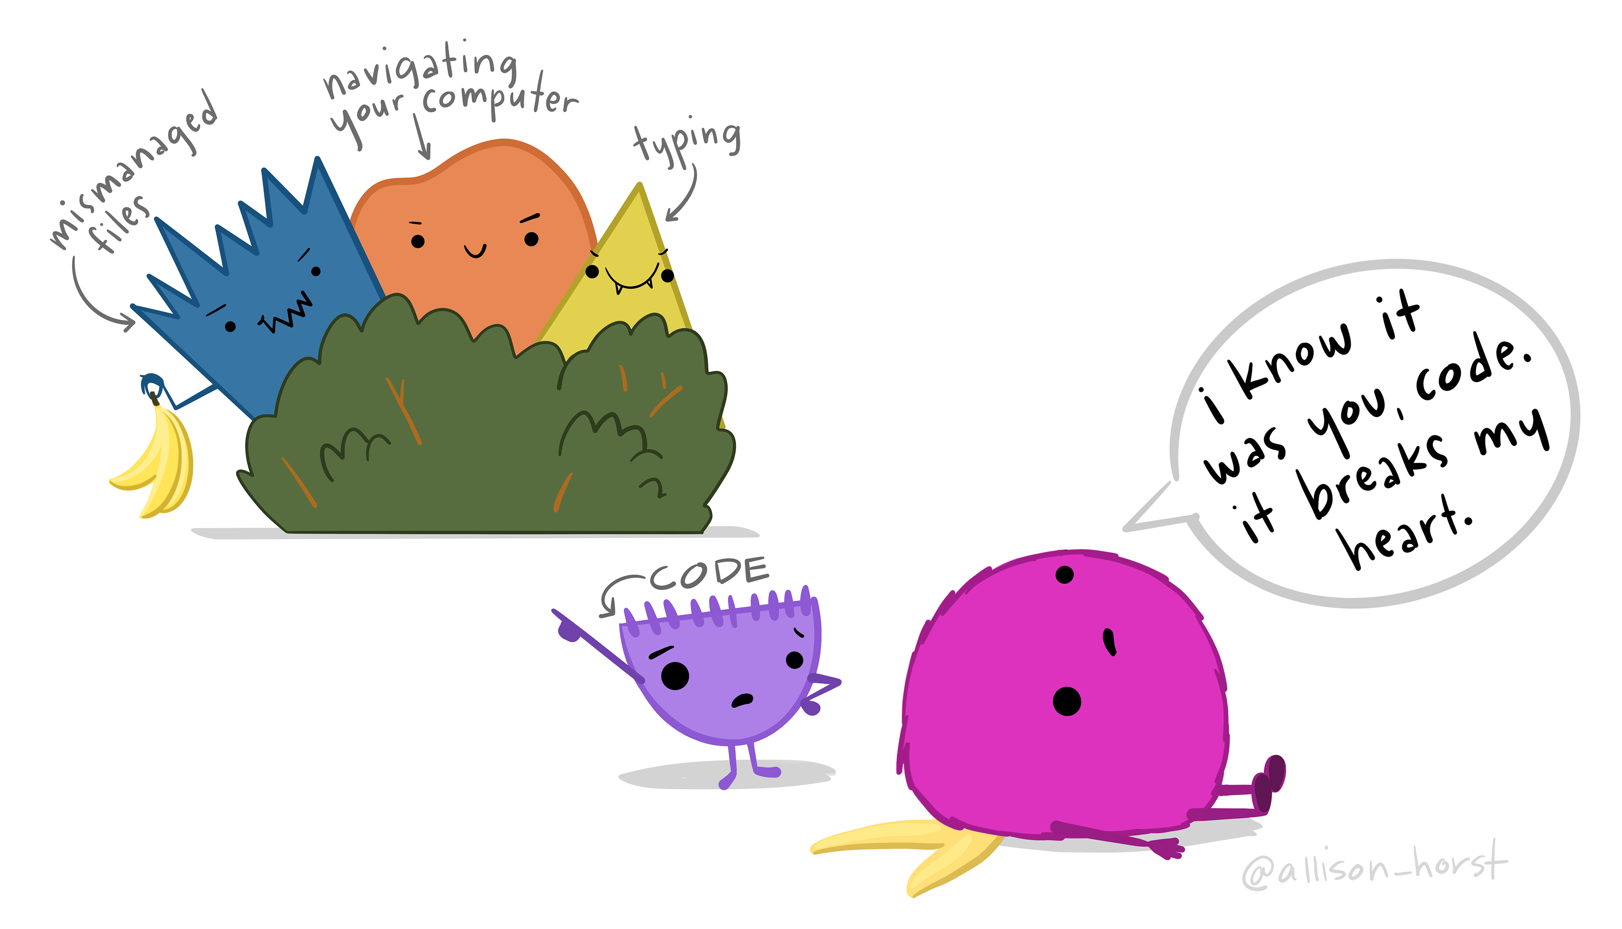
Notes:
A friendly monster has slipped on a banana peel, and says "I know it was you, code. It breaks my heart." Meanwhile, a little character labeled "CODE" looks on indignantly, pointing to evil characters labeled "mismanaged files," "navigating your computer", and "typing" hiding behind a bush holding a bunch of bananas. The point being: often folks blame code for data science problems that are often caused by other underlying issues.

